Slide 1
TRAVEL AND TOURISM
GUIDE
Dr. Rama Devi Burri
Associate Professor
TEAM MEMBERS
M. Kreshnaa (19761A1296)
P. Yugala (19761A12A8)
G. Siva krishna (19761A1282)
T. Navya chandrika (19761A12C0)
N.Vishnu sai(20765A1209)

Slide 2
abstract
Tourism management system is a complete tourist fully integrated tourism website. The website covers all the areas required for an including tourism. This project is devoloped to manage the tourist in the tourism management website .The main module in this project are login,tourist management,complaints and reports

Slide 3
Problem statement
Our priority will be our customers and their travel requirements
There will be many users visiting the portal and hence we require a strong and reliable frontend which can withhold the users on our site.
The data will be consisting is very important that can help everyone and hence we need a strong database
We need to build a world class team armed with knowledge and backed by technology to advise customers in planning of their holidays and to answer their queries.
We will be putting an effort to provide that right choice to the people when they plan a holiday and beware them from the false advertising.

Slide 4
Existing system
In the existing system, all the records are not kept perfectly because all the work is done manually, so keeping up to date details of vehicles, timings of bookings, seats availability for reservation, vehicles or rooms/hotels availability is not done. Amount of the overall trips are kept in documents and the caluclations done are manually which made lead to huge mistakes
Thus, the existing system is very time consuming and bring manual work sometimes lead to a great loss as well.

Slide 5
objectives
Our objective is to offer a variety of travel services that are sure to match all your priorities.
Our objectives is to globalism, organize, standardize and goal of journey towards perfectionism.
Our objective is to make strong relationship with customers so that they can enjoy the holiday of their dreams.
Our objective is just an initiative, it will be made to more further and developed work of art.

Slide 6
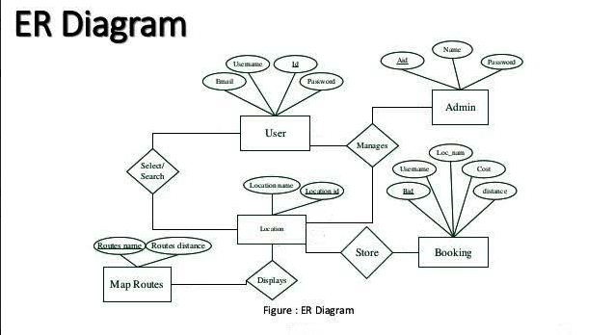
er diagram

Slide 7
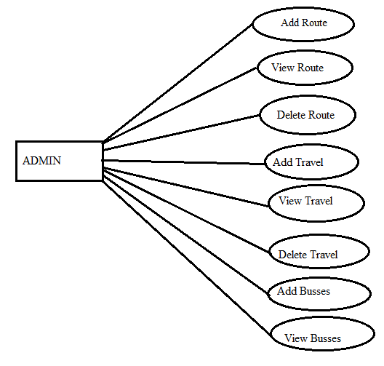
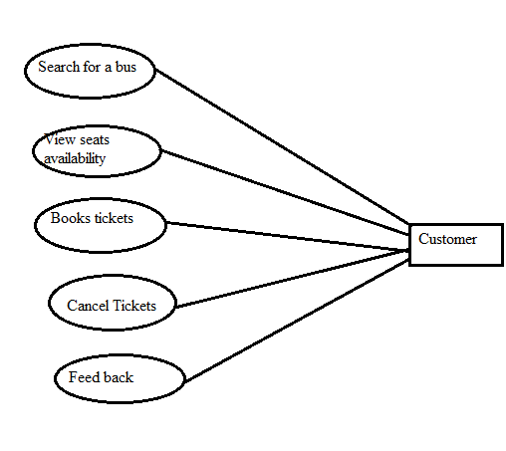
USECASE

Slide 8
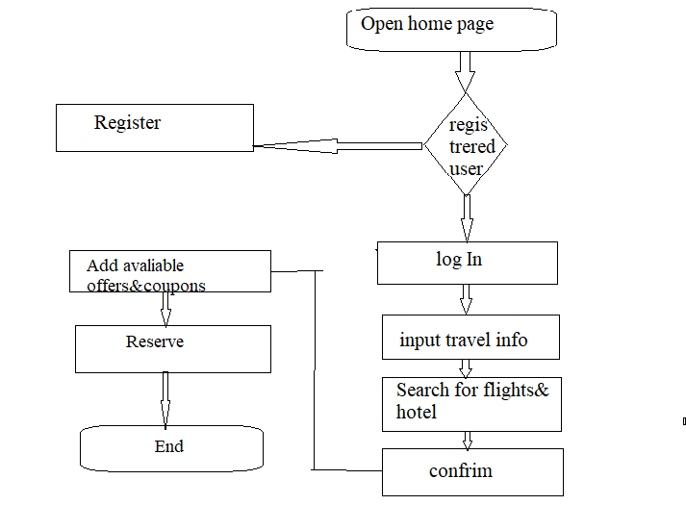
Flow chart

Slide 9
System design
Making of front end.
Creating various table in database as needed.
Connection of front end to back end.
Updation of candidates detail by admin.
Doing respective jobs.
Declaring of result.

Slide 10
REQUIREMENTS
Basic knowledge on HTML,PHP,Javascript,bootstrap to design the website.
Knowledge on phpmyadmin to administrate the data over website
Operating system: windows / MAC /Linux
Xampp server

Slide 11
FUTURE SCOPE
Any tourist agency can make use of it for saving customer details in database
Tourism group can use it for managing their location, hotel, vehicels details
We can add new features as and when we require.
Reusability of this application also possible.

Slide 12
CONCLUSION
“Travel and tourism management” simplifies the management process in travelling
Fast processing and immediate results with high security
Minimizing human effort and cost efficient databases
Navigatition through the site is easy

Slide 13
THANK YOU

